Slide 1

Module 5 Exception Handling
Example Programs

Slide 2
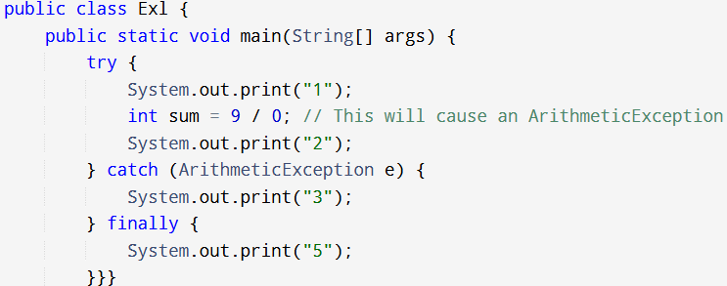

Example 1

Slide 3
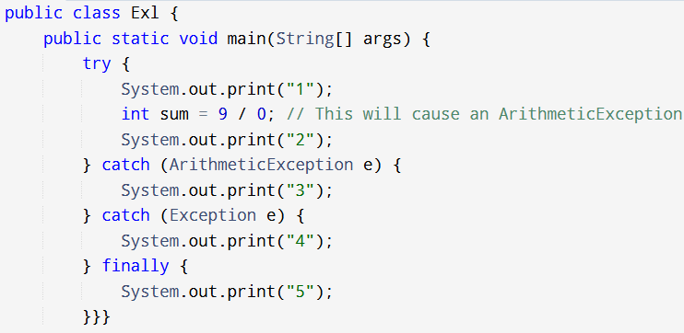
Example 2: Multiple Catch clause

Slide 4
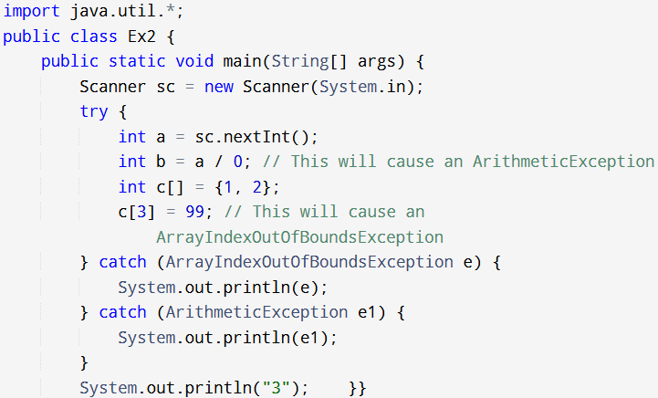
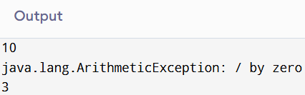
Example 3: Multiple Catch clause

Slide 5
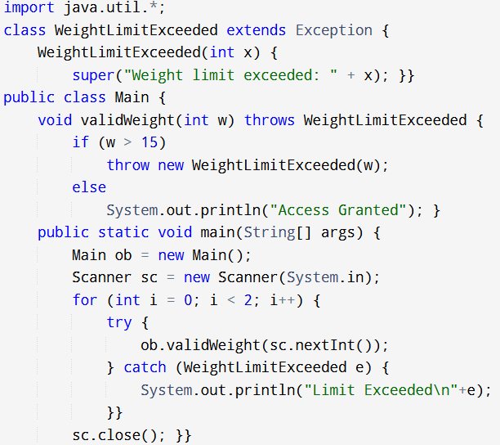
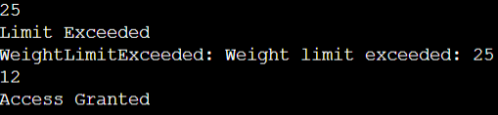

Slide 6
Try 1. Checking Age
Create a class called 'checkage'. It has a constructor with takes a single parameter 'x' of int datatype.
In the Main class, using the proper syntax declare the new exception called 'checkage' using the method 'validage' have a parameter 'age' of int datatype. If the age obtained is less than 18, it should throw the new exception else, print "Eligible to vote".
In the Main class,
1. Call for a user-defined input.
2. Call the method 'validage' using the appropriate manner in the try block.
If an exception occurs, the catch block should print "Not Eligible to vote".

Slide 7
2.
Create a class called ‘agecheck'. It has a method called ‘check’ with takes a single parameter 'x' of int datatype.
A subclass called ‘conditions’ extends the properties of the class ‘checkage’. Using the proper syntax declare the new exception called ‘agecheck' using the method 'validage' have a parameter 'age' of int datatype. If the age obtained is less than 18, it should throw the new exception else, print "Eligible to vote".
In the Main class,
1. Call for a user-defined input.
2. Call the method 'validage' using the appropriate manner in the try block.
If an exception occurs, the catch block should print "Not Eligible to vote".

Slide 8
3. Area of rectangle
Write a Java program to find the area of a rectangle and print "Good" if the area is more than 50 or print "Bad" if otherwise using exception handling.
Create a class called 'values' containing 2 variables 'l' and 'b'. This class also contains a method called ‘display’ having 2 int parameters. This method is of int datatype.
In the Main class
1. using the appropriate syntax, create the new Exception 'values' using the method 'checkarea'. This method is of int datatype and has a single parameter area1. Here check the value of area1 using if-else statements. If the area1 value is less than 50, an exception is to be thrown else, the statement "Good" is to printed.
2. Take two user-defined values. Pass these values correctly in the method 'display'. Call the method 'display' by creating objects using the correct class name. Assign the output of 'display' to a variable called area1.
3. Create an object using the appropriate class for calling the method 'checkarea' in the try block. If an exception occurs, the program has to shift to the catch clause, which contains the statement "Bad".

Slide 9
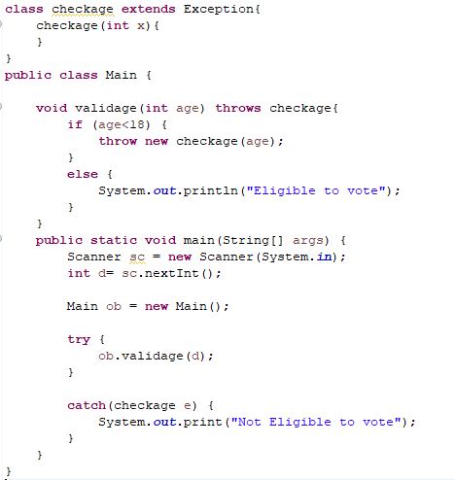
1. Solution

Slide 10
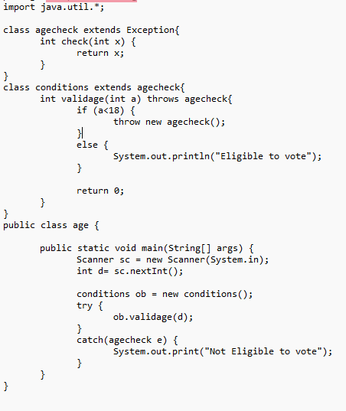
2.

Slide 11
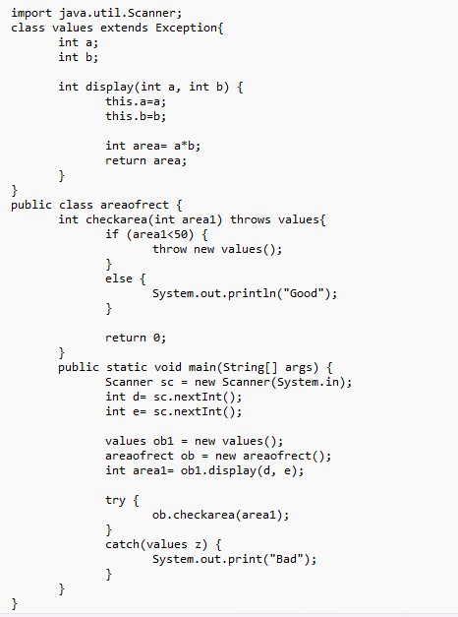
3.

Slide 12
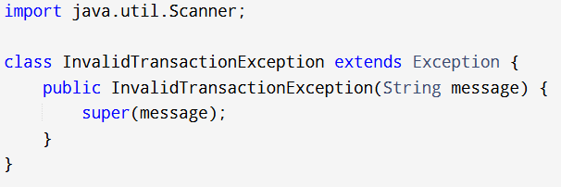

Slide 13
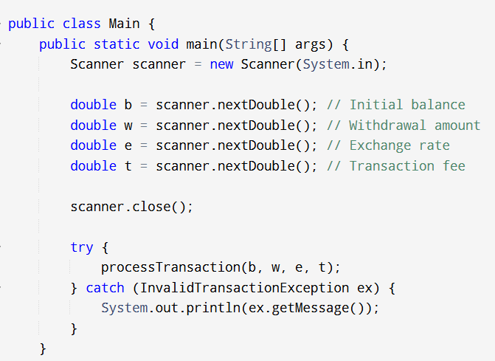

Slide 14
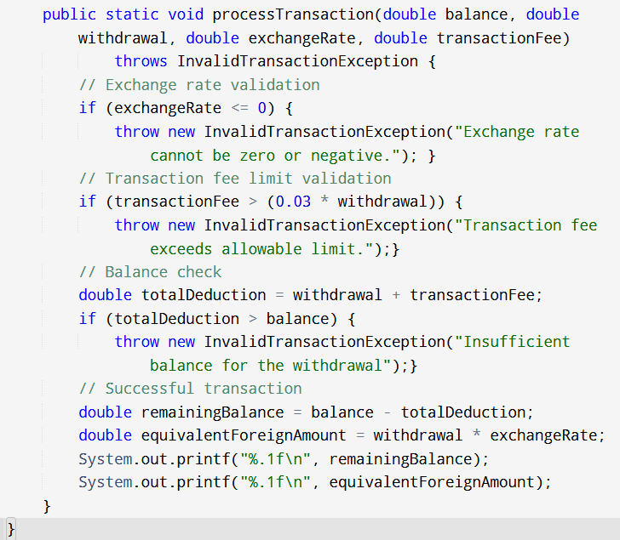

Slide 15
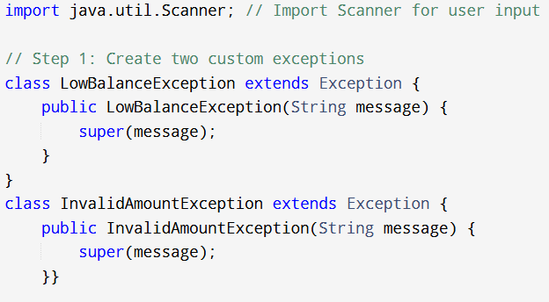
EXAMPLE FOR TWO EXCEPTIONS

Slide 16
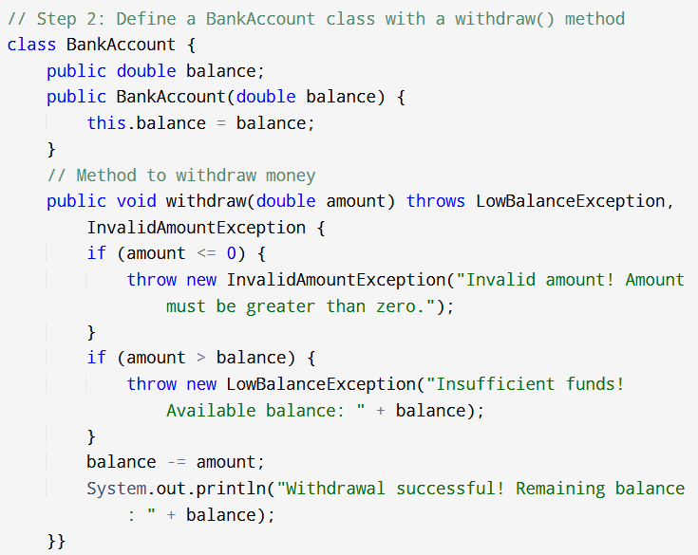
EXAMPLE FOR TWO EXCEPTIONS

Slide 17
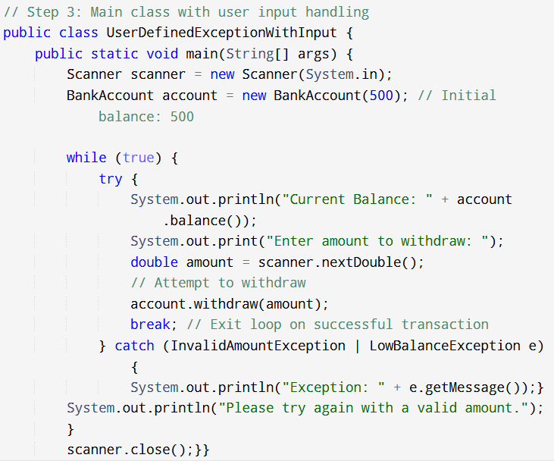
EXAMPLE FOR TWO EXCEPTIONS

